Slide 1
News App
By
Naga Akhil Kumar Madduri

Slide 2

Agenda
Introduction
Micro Services
Requirements
Conclusion

Slide 3
Introduction
The main objective of the project is to provide people with a handy application through which people can access all types of news and information. Through this application, any user can gain technical knowledge of the world and its surrounding with just one click ahead. The user does not have to visit multiple sites for different related information. All information is going to be in one place.

Slide 4
Micro Services

Slide 5
Micro Services
Sign up and Login
Technology
Unregistered users can use sign up page to register themselves. Then users who have registered can use the login page to login to the website.
In this where we can find technology related news on science and Apps.
Education related posts were also posted in this micro service.

Slide 6
Micro Services
Life Style
Articles
Contact Us
In this where we can find lifestyle categories news on Fashion, Food and Fitness.
This is the process where we can find the news on different articles
In this we can contact through the email for any related issues.
For any queries we can contact through email.
Will be sure to get back to you as soon as possible.

Slide 7
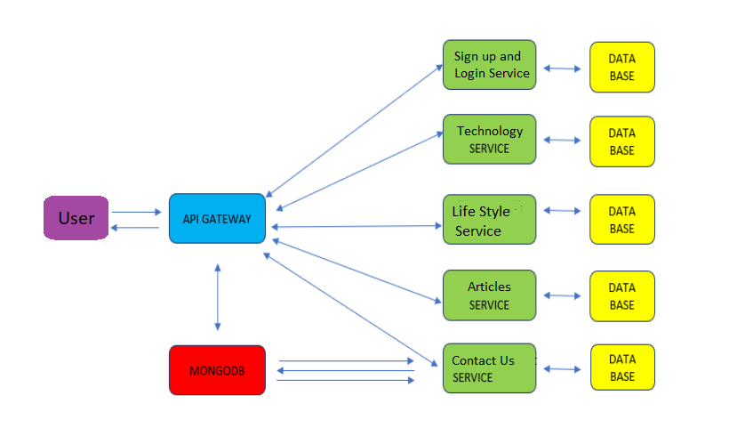
Architecture

Slide 8
Requirements
1. STS IDE
2. Mongo DB
3. Java Jdk11
4. Postman

Slide 9
Hardware Requirement
For developing the application, the following are the Hardware Requirements:
1.Processor: Intel i3 or above
2.RAM: 8 GB
3.Space on Hard Disk: minimum 20GB

Slide 10
Conclusion
This is a fast-evolving world with modernization taking a toll on the world, people nowadays prefer to spend time more on their mobile rather than read a newspaper. NewApp is an android application which makes newspaper reading much interesting and easier. The easily usable UI makes this application very user friendly and most of all save’s time.

Slide 11
Thank you

